Slide 1
Math 152 – Lesson 22
Lesson | Topic | Reading
20/21 | Separable Equations | 9.3
22 | Models for Population Growth | 9.4
23 | Sequences | 11.1
Objectives:
Translate statements involving rates into differential equation models and solve model applying given conditions
Formulate & solve population models using differential equations
GR and FSE next week!

Slide 2
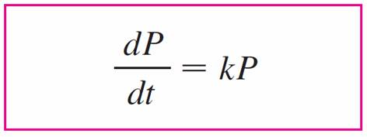
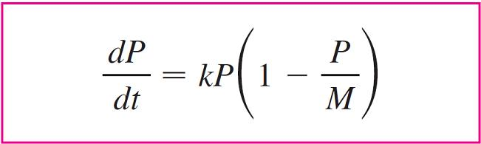
Population Growth Models
Natural Growth
No limits
Logistical Growth
Reality limits growth due to fixed resources

Slide 3
Natural Growth Model
Separable Eqn
ln | P | = kt + C
| P | = e^{kt + C} = e^{C}e^{kt}
P = P₀e^{kt} where P(0) = P₀
Accounting for emigration (or “harvesting”), the equation becomes:

Slide 4
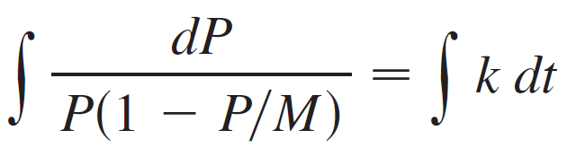
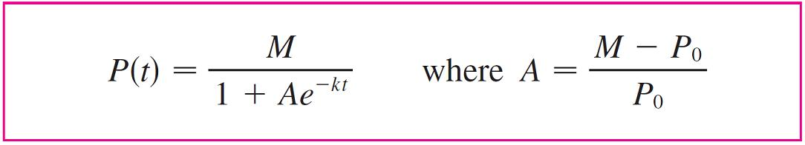
Logistic Model
Reality limits a populations growth: food, water, living area, etc
Logistics: think military “beans & bullets”
Partial fractions:
P: B-A=0
1: A=1

Slide 5
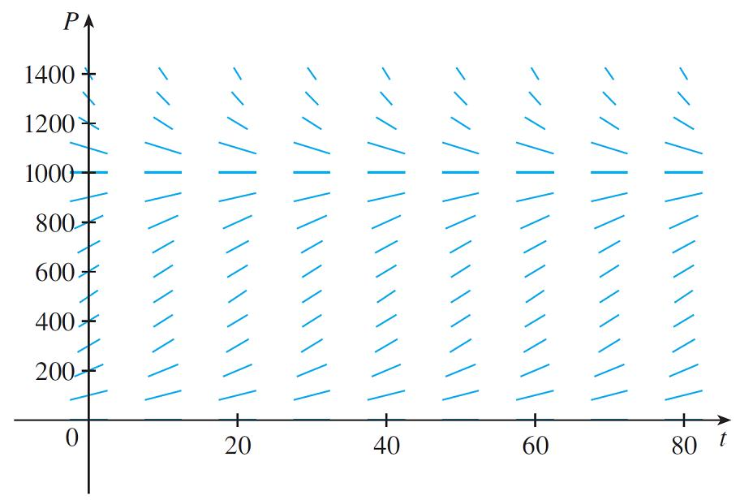
Example
What is the growth equation for a population with k = 0.08 and carrying capacity M = 1000. What type of model is this? What can you deduce about the solutions?
Solution:
In this case the logistic differential equation is

Slide 6
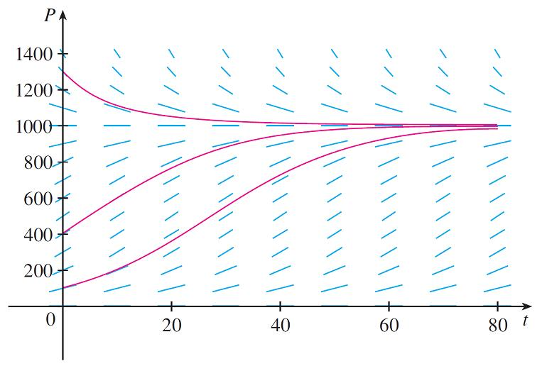
Example
Given the direction field, sketch solution curves with initial populations of P(0) = 100, P (0) = 400, and P (0) = 1300.

Slide 7
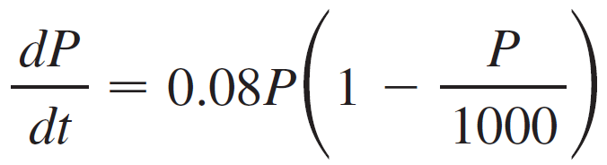
Example
Write the solution of the initial-value problem
P (0) = 100
and use it to find the population sizes P(40) and P(80). At what time does the population reach 900?

Slide 8
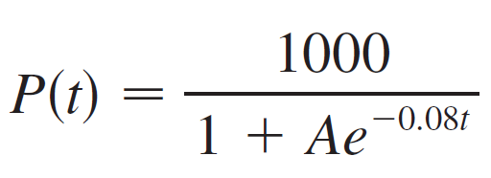
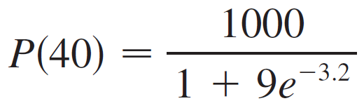

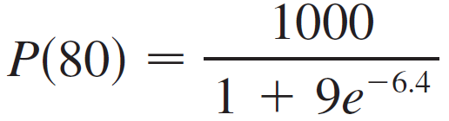
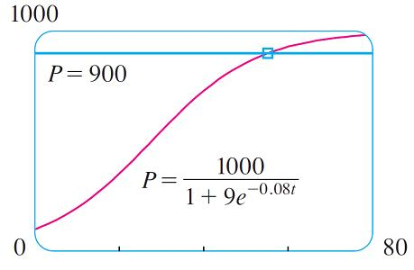
Solution
t ≈ 55

Slide 9
Other Models
Logistics Model with harvesting
Ex: Think of a population of fish being caught at a constant rate
Logistics Model with a minimum population level m below which the species tends to become extinct
Ex: Adults may not find suitable mates if the population size is too small
Once the population P hits the minimum level m, then the rate becomes 0

Slide 10
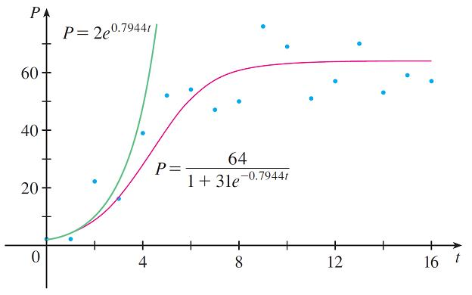
Comparison of Models
In the 1930s the biologist G. F. Gause conducted an experiment with protozoa
He estimated the initial relative growth rate to be 0.7944 and the carrying capacity to be 64

Slide 11
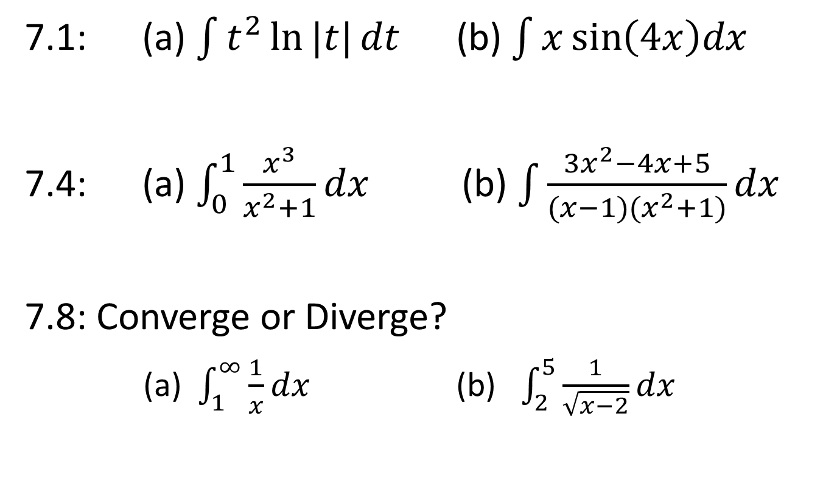
GR Review
7.1: (a) $\int{t^{2}\ln{|t|}dt}$ (b) $\int{x\sin\left(4x\right)dx}$
7.4: (a) $\int_{0}^{1}{\frac{x^{3}}{x^{2}+1}dx}$ (b) $\int{\frac{3x^{2}−4x+5}{(x−1)(x^{2}+1)}dx}$
7.8: Converge or Diverge?
(a) $\int_{1}^{∞}{\frac{1}{x}dx}$ (b) $\int_{2}^{5}{\frac{1}{\sqrt{x−2}}dx}$

Slide 12
Backups

Slide 13

Board Work
For what values of k does the function $y=\cos\left(kt\right)$ satisfy the differential equation $4y^{′′}=−25y$? (answer: +/- 5/2)
Notes:
+- 5/2

Slide 14
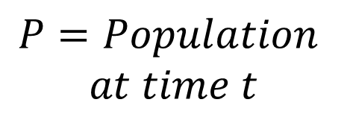

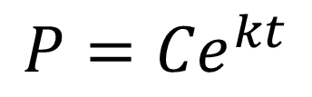
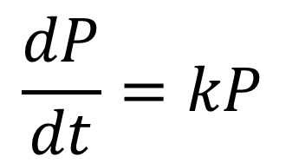
Population Growth
Model: Over time, population grows at a rate proportional to the size of the population.
Variables:
Differential Equation:
$$\frac{dP}{dt}=kP$$
$$t=Time$$
$$P=Population$$
$$at time t$$
General Solution:
$$P={Ce}^{kt}$$

